Slide 1
Civil Liberties and Civil Rights
AP U.S. Government & Politics
Unit 7

Slide 2
Latin and the Law
stare decisis
in loco parentis
parens patriae
ipso facto
de facto
de jure
quid pro quo

Slide 3
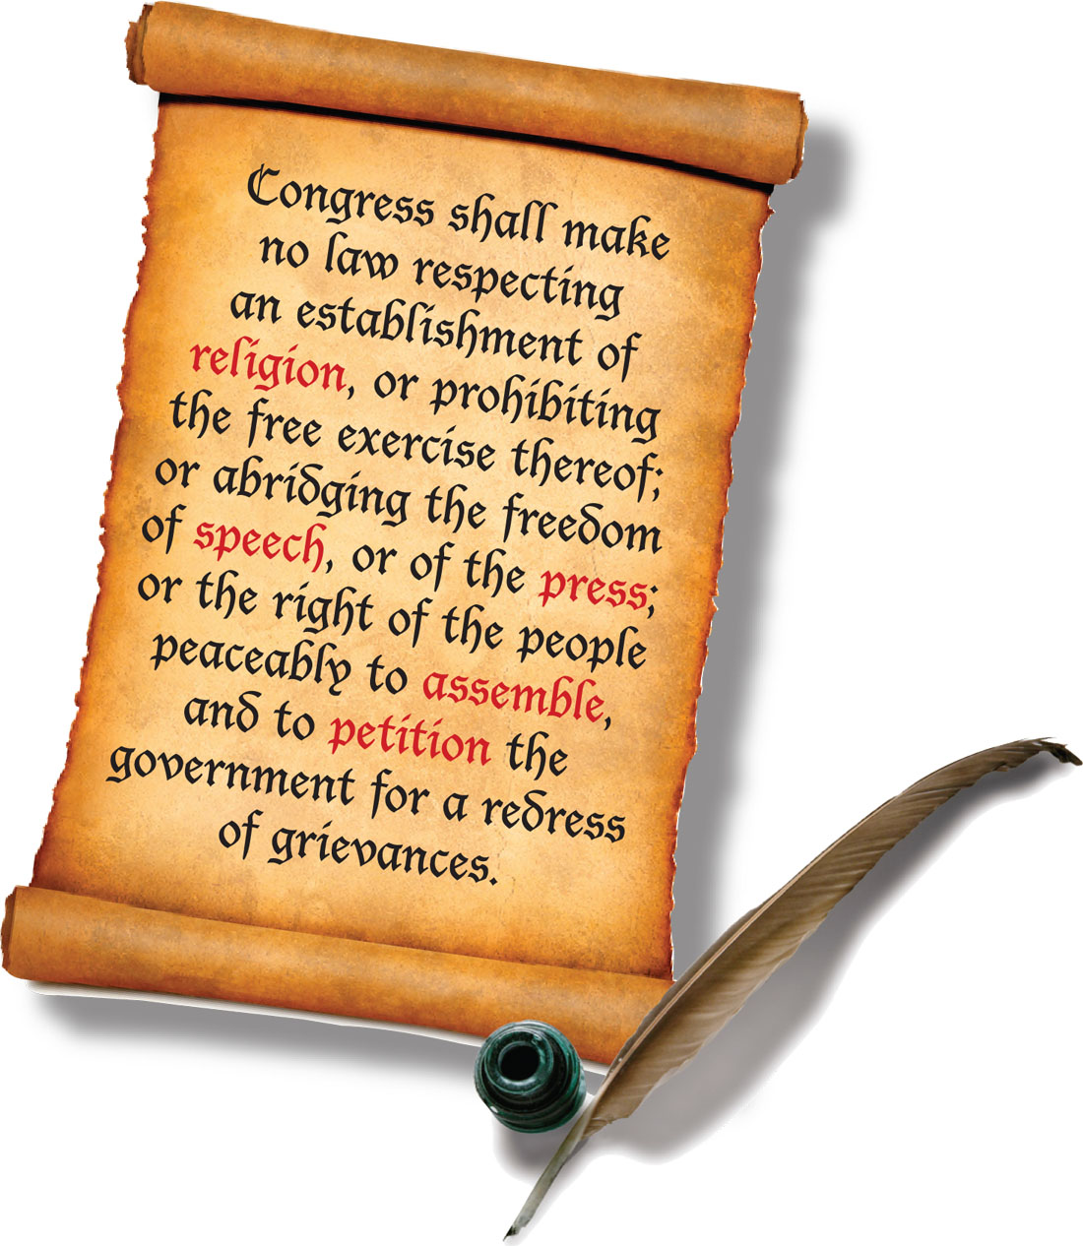
The Bill of Rights
The Bill of Rights is…
The Bill of Rights is not…
A list of things the government CANNOT do
A “check” on the powers of the federal government (originally) and now on all governments (since Gitlow)
A list of rights or liberties given to the people by the government
A complete list of all individual liberties or rights

Slide 4
The Ninth Amendment
The enumeration in the Constitution, of certain rights, shall not be construed to deny or disparage others retained by the people.

Slide 5
The Fourteenth Amendment
All persons born or naturalized in the United States, and subject to the jurisdiction thereof, are citizens of the United States and of the State wherein they reside. No State shall make or enforce any law which shall abridge the privileges or immunities of citizens of the United States; nor shall any State deprive any person of life, liberty, or property, without due process of law; nor deny to any person within its jurisdiction the equal protection of the laws.

Slide 6
Does the Bill or Rights apply to the states?
NO (Barron v. Baltimore)
YES (Gitlow v. New York)
The Constitution was [created] by the people of the United States for themselves, for their own government, and not for the government of the individual States.
Had the people of the [states] required changes in their Constitutions, had they required additional safeguards…from the…encroachments of their particular [state] governments, the remedy was in their own hands, and could have been applied by themselves.
In almost every convention by which the Constitution was adopted, amendments to guard against the abuse of power were recommended. These amendments demanded security against the apprehended encroachments of the General Government -- not against those of the local governments.…[They] contain no expression indicating an intention to apply them to the State governments.
The precise question presented, and the only question which we can consider under this writ of error, then is whether the statute, as construed and applied in this case by the state courts, deprived the defendant of his liberty of expression in violation of the due process clause of the Fourteenth Amendment.
For present purposes, we may and do assume that freedom of speech and of the press which are protected by the First Amendment from abridgment by Congress are among the fundamental personal rights and "liberties" protected by the due process clause of the Fourteenth Amendment from impairment by the States….
We cannot hold that the present statute is an arbitrary or unreasonable exercise of the police power of the State unwarrantably infringing the freedom of speech or press, and we must and do sustain its constitutionality.

Slide 7
Freedom of Speech
First Amendment
Congress shall make no law respecting an establishment of religion, or prohibiting the free exercise thereof; or abridging the freedom of speech, or of the press; or of the people peaceably to assemble, and to petition the Government for a redress of grievances.”

Slide 8
What does the First Amendment protect?
The protection given speech and press was fashioned to assure unfettered interchange of ideas for the bringing about of political and social changes desired by the people….
All ideas having even the slightest redeeming social importance - unorthodox ideas, controversial ideas, even ideas hateful to the prevailing climate of opinion - have the full protection of the guaranties, unless excludable because they encroach upon the limited area of more important interests.
Mr. Justice Brennan
Roth v. United States (1957)

Slide 9
Free Speech
First Amendment protects most every form of speech, and especially speech that concerns a serious political, social, or religious message
First Amendment protects various forms of speech:
  pure speech (words alone)
  speech and action (words plus action)
  symbolic speech (action/object, in place of words)

Slide 10
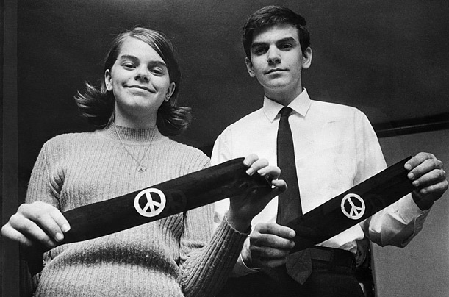
John and Mary Beth Tinker

Slide 11
Do students have rights at school?
First Amendment rights, applied in light of the special characteristics of the school environment, are available to teachers and students. It can hardly be argued that either students or teachers shed their constitutional rights to freedom of speech or expression at the schoolhouse gate….
In order for…school officials to justify prohibition of a particular expression of opinion, [they] must be able to show that its action was caused by something more than a mere desire to avoid the discomfort and unpleasantness that always accompany an unpopular viewpoint. Certainly where there is no finding and no showing that engaging in the forbidden conduct would "materially and substantially interfere with the requirements of appropriate discipline in the operation of the school," the prohibition cannot be sustained.
Mr. Justice Fortas
Tinker v. Des Moines (1969)

Slide 12

Gregory Lee Johnson

Slide 13
“Clear and Present Danger”
But the character of every act depends upon the circumstances in which it is done. The most stringent protection of free speech would not protect a man in falsely shouting fire in a theatre and causing a panic. It does not even protect a man from an injunction against uttering words that may have all the effect of force. The question in every case is whether the words used are used in such circumstances and are of such a nature as to create a clear and present danger that they will bring about the substantive evils that Congress has a right to prevent. It is a question of proximity and degree.
Mr. Justice Holmes
Schenck v. United States (1919)

Slide 14
“Fighting Words”
…[I]t is well understood that the right of free speech is not absolute at all times and under all circumstances. There are certain well-defined and narrowly limited classes of speech, the prevention and punishment of which have never been thought to raise any Constitutional problem. These include… insulting or "fighting" words – those which by their very utterance inflict injury or tend to incite an immediate breach of the peace. It has been well observed that such utterances are no essential part of any exposition of ideas, and are of such slight social value as a step to truth that any benefit that may be derived from them is clearly outweighed by the social interest in order and morality….
Mr. Justice ___
Chaplinsky v. New Hampshire (1942)

Slide 15
Vulgarity or Obscenity?
How is one to distinguish this from any other offensive word? Surely the State has no right to cleanse public debate to the point where it is grammatically palatable to the most squeamish among us.…For, while the particular four-letter word being litigated here is perhaps more distasteful than most others of its genre, it is nevertheless often true that one man's vulgarity is another's lyric. Indeed, we think it is largely because governmental officials cannot make principled distinctions in this area that the Constitution leaves matters of taste and style so largely to the individual.
Mr. Justice Harlan
Cohen v. California (1971)

Slide 16
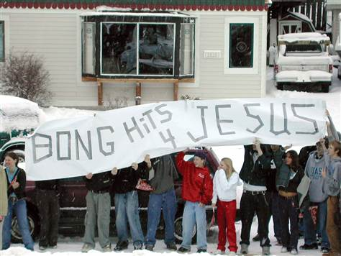
Morse v. Frederick

Slide 17
Religious Freedom
First Amendment
Congress shall make no law respecting an establishment of religion, or prohibiting the free exercise thereof; or abridging the freedom of speech, or of the press; or of the people peaceably to assemble, and to petition the Government for a redress of grievances.”

Slide 18
Which of the following do you think best defines the Establishment Clause?
  The Establishment Clause means the government can’t support any one specific religion, but it can certainly support religion in general
    For example, it’s OK that our money has the words “In God We Trust” on it, or it’s OK if Congress provides funds to religious charities as long as it doesn’t exclude certain ones
  The Establishment Clause means the government must remove any perceived support of religion
    For example, Congress should remove the words “In God We Trust” because that implies an endorsement of a belief in God, or a city should never put a Christmas tree on its property because that implies an endorsement of Christianity

Slide 19

School Bus Case
We cannot say that the First Amendment prohibits New Jersey from spending tax-raised funds to pay the bus fares of parochial school pupils as a part of a general program under which it pays the fares of pupils attending public and other schools. It is undoubtedly true that children are helped to get to church schools….[S]tate-paid policemen, detailed to protect children going to and from church schools from the very real hazards of traffic, would serve much the same purpose and accomplish much the same result as state provisions intended to guarantee free transportation of a kind which the state deems to be best for the school children's welfare….Similarly, parents might be reluctant to permit their children to attend schools which the state had cut off from such general government services as ordinary police and fire protection, connections for sewage disposal, public highways and sidewalks. Of course, cutting off church schools from these services so separate and so indisputably marked off from the religious function would make it far more difficult for the schools to operate. But such is obviously not the purpose of the First Amendment.
Mr. Justice Black
Everson v. Board of Education (1947)

Slide 20
School Prayer
We think that, by using its public school system to encourage recitation of the Regents' prayer, the State of New York has adopted a practice wholly inconsistent with the Establishment Clause…. Neither the fact that the prayer may be denominationally neutral nor the fact that its observance on the part of the students is voluntary can serve to free it from the limitations of the Establishment Clause, as it might from the Free Exercise Clause, of the First Amendment, both of which are operative against the States by virtue of the Fourteenth Amendment.
Mr. Justice Black
Engel v. Vitale (1962)

Slide 21
School Prayer
It makes no sense to say that Alabama has "endorsed prayer" by merely enacting a new statute "to specify expressly that voluntary prayer is one of the authorized activities during a moment of silence." To suggest that a moment-of-silence statute that includes the word "prayer" unconstitutionally endorses religion, while one that simply provides for a moment of silence does not, manifests not neutrality, but hostility, toward religion.
Mr. Chief Justice Burger (dissenting)
Wallace v. Jaffree (1985)

Slide 22
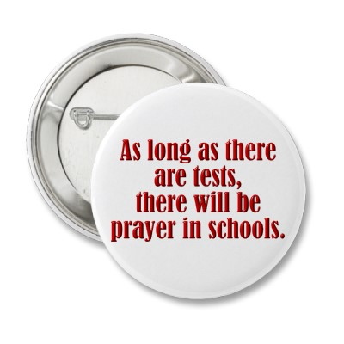
School Prayer
With all respect, I think the Court has misapplied a great constitutional principle. I cannot see how an "official religion" is established by letting those who want to say a prayer say it. On the contrary, I think that to deny the wish of these school children to join in reciting this prayer is to deny them the opportunity of sharing in the spiritual heritage of our Nation.
Mr. Justice Stewart (dissenting)
Engel v. Vitale (1962)

Slide 23
The “Lemon Test”
In the absence of precisely stated constitutional prohibitions, we must draw lines with reference to the three main evils against which the Establishment Clause was intended to afford protection: "sponsorship, financial support, and active involvement of the [government] in religious activity."
Every analysis in this area must begin with consideration of the cumulative criteria developed by the Court over many years. Three such tests may be gleaned from our cases. First, the statute must have a secular legislative purpose; second, its principal or primary effect must be one that neither advances nor inhibits religion; finally, the statute must not foster "an excessive government entanglement with religion."
Mr. Chief Justice Burger
Lemon v. Kurtzman (1971)

Slide 24
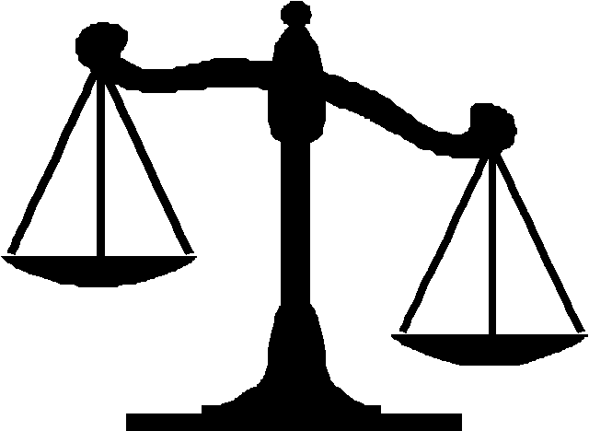
Deciding Free-Exercise Cases
Freedom to Practice One’s Religion
Government’s Compelling Interest

Slide 25
Work on the Sabbath
We turn first to the question whether the disqualification for benefits imposes any burden on the free exercise of [Verner’s] religion….Here not only is it apparent that [the] declared ineligibility for benefits derives solely from the practice of her religion, but the pressure upon her to forego that practice is unmistakable. The [previous court’s] ruling forces her to choose between following the precepts of her religion and forfeiting benefits, on the one hand, and abandoning one of the precepts of her religion in order to accept work, on the other hand. Governmental imposition of such a choice puts the same kind of burden upon the free exercise of religion as would a fine imposed against appellant for her Saturday worship.
Mr. Justice Brennan
Sherbert v. Verner (1963)

Slide 26
Work on the Sabbath
We must next consider whether some compelling state interest enforced in the eligibility provisions of the South Carolina statute justifies the substantial infringement of [Verner’s] First Amendment right. It is basic that no showing merely of a rational relationship to some colorable state interest would suffice; in this highly sensitive constitutional area, "[o]nly the gravest abuses, endangering paramount interests, give occasion for permissible limitation." No such abuse or danger has been advanced in the present case.
Mr. Justice Brennan
Sherbert v. Verner (1963)

Slide 27

Must the Amish send their children to school?
[A] State's interest in universal education, however highly we rank it, is not totally free from a balancing process when it impinges on fundamental rights and interests, such as those specifically protected by the Free Exercise Clause of the First Amendment, and the traditional interest of parents with respect to the religious upbringing of their children so long as they "prepare [them] for additional obligations….” [O]nly those interests of the highest order and those not otherwise served can overbalance legitimate claims to the free exercise of religion. We can accept it as settled, therefore, that, however strong the State's interest in universal compulsory education, it is by no means absolute to the exclusion or subordination of all other interests.
Mr. Chief Justice Burger
Wisconsin v. Yoder (1972)

Slide 28
Must the Amish send their children to school?
I agree with the Court that the religious scruples of the Amish are opposed to the education of their children beyond the grade schools, yet I disagree with the Court's conclusion that the matter is within the dispensation of parents alone….Recent cases, however, have clearly held that the children themselves have constitutionally protectable interests. These children are "persons" within the meaning of the Bill of Rights. We have so held over and over again….On this important and vital matter of education, I think the children should be entitled to be heard.
Mr. Justice Douglas (dissenting, in part)
Wisconsin v. Yoder (1972)

Slide 29
Due Process Clauses
[N]or shall any person…be deprived of life, liberty, or property, without due process of law…
-- Fifth Amendment
[N]or shall any State deprive any person of life, liberty, or property, without due process of law…
-- Fourteenth Amendment

Slide 30

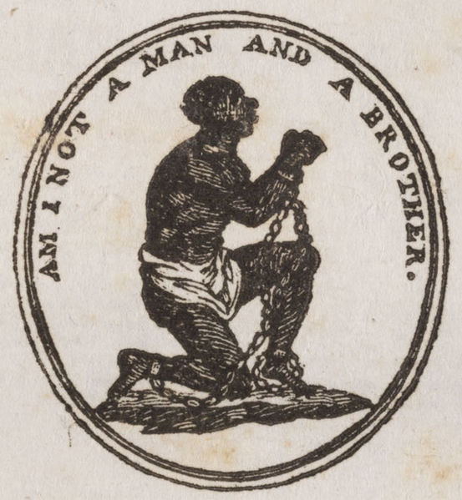
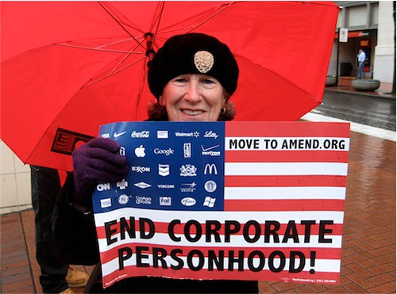
Personhood

Slide 31
Standards for a Legal Search
* only in situations where a person has a “reasonable expectation of privacy”
“Probable Cause”
“Reasonable Suspicion”
a higher standard that police must meet
police must have trustworthy and specific information that leads them to believe a crime has been committed and evidence will be found
probable cause must be demonstrated to acquire a search warrant
a lower standard that police must meet
police must have specific information that leads them to believe a crime is at hand
reasonable suspicion is enough to justify a “frisk” or vehicle search, but not a thorough or invasive search

Slide 32
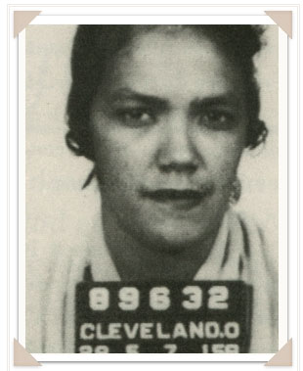
Mapp v. Ohio (1961)

Slide 33
Can illegally seized evidence be used in court?
…[O]ur holding that the exclusionary rule is an essential part of both the Fourth and Fourteenth Amendments is not only the logical dictate of prior cases, but it also makes very good sense. There is no war between the Constitution and common sense. Presently, a federal prosecutor may make no use of evidence illegally seized, but a State's attorney across the street may, although he supposedly is operating under the enforceable prohibitions of the same Amendment. Thus the State, by admitting evidence unlawfully seized, serves to encourage disobedience to the Federal Constitution which it is bound to uphold.
Mr. Justice Clark
Mapp v. Ohio (1961)

Slide 34
Can illegally seized evidence be used in court?
…There are those who say…that under our constitutional exclusionary doctrine “[t]he criminal is to go free because the constable has blundered.” In some cases this will undoubtedly be the result. But,…“there is another consideration - the imperative of judicial integrity.” The criminal goes free, if he must, but it is the law that sets him free. Nothing can destroy a government more quickly than its failure to observe its own laws, or worse, its disregard of the charter of its own existence. As Mr. Justice Brandeis, dissenting, said in Olmstead v. United States (1928): “Our Government is the potent, the omnipresent teacher. For good or for ill, it teaches the whole people by its example. . . . If the Government becomes a lawbreaker, it breeds contempt for law; it invites every man to become a law unto himself; it invites anarchy.”
Mr. Justice Clark
Mapp v. Ohio (1961)

Slide 35
Can illegally seized evidence be used in court?
The wrong condemned by the [Fourth] Amendment is “fully accomplished” by the unlawful search or seizure itself, and the exclusionary rule is neither intended nor able to “cure the invasion of the defendant's rights which he has already suffered.” The rule thus operates as “a judicially created remedy designed to safeguard Fourth Amendment rights generally through its deterrent effect, rather than a personal constitutional right of the party aggrieved….” We conclude that the marginal or nonexistent benefits produced by suppressing evidence obtained in objectively reasonable reliance on a subsequently invalidated search warrant cannot justify the substantial costs of exclusion. We do not suggest, however, that exclusion is always inappropriate in cases where an officer has obtained a warrant and abided by its terms.
Mr. Justice White
United States v. Leon (1984)

Slide 36
Is the death penalty “cruel and unusual?”
These death sentences are cruel and unusual in the same way that being struck by lightning is cruel and unusual. For, of all the people convicted of rapes and murders in 1967 and 1968, many just as reprehensible as these, the petitioners are among a capriciously selected random handful upon whom the sentence of death has in fact been imposed. My concurring Brothers have demonstrated that, if any basis can be discerned for the selection of these few to be sentenced to death, it is the constitutionally impermissible basis of race. But racial discrimination has not been proved, and I put it to one side. I simply conclude that the Eighth and Fourteenth Amendments cannot tolerate the infliction of a sentence of death under legal systems that permit this unique penalty to be so wantonly and so freakishly imposed.
Mr. Justice Stewart
Furman v. Georgia (1972)

Slide 37
Important Due Process Cases
Case | Principle/Amendment | Ruling
Mapp | Searches & seizures Fourth Amendment | Illegally seized evidence must be excluded from trial (“exclusionary rule”)
U.S. v. Leon | Searches & Seizures Fourth Amendment | Illegally seized evidence is permissible if the officer served the warrant in “good faith”
Escobedo | Self-incrimination/Fifth Right to counsel/Sixth | A suspect’s confession cannot be used in court if he was denied access to an attorney
Gideon | Right to counsel Sixth Amendment | State must provide an attorney to poor defendants since legal counsel is vital
Miranda | Self-incrimination/Fifth Right to counsel/Sixth | Requires police to inform a suspect of his rights to not self-incriminate, attorney
Furman | Cruel & Unusual punishment Eighth Amendment | Required death penalty laws to be evenly applied (created 4-year moratorium)

Slide 38
Landmark Civil Rights Cases
In Plessy, how does the Court interpret the Fourteenth Amendment’s “equal protection” clause?
What is the Court’s legal reasoning for upholding segregation in Plessy? Explain.
What is the Court’s legal reasoning for rejecting the “separate but equal” doctrine in Brown? Explain.

Slide 39
Fourteenth Amendment
All persons born or naturalized in the United States, and subject to the jurisdiction thereof, are citizens of the United States and of the State wherein they reside. No State shall make or enforce any law which shall abridge the privileges or immunities of citizens of the United States; nor shall any State deprive any person of life, liberty, or property, without due process of law; nor deny to any person within its jurisdiction the equal protection of the laws.

Slide 40
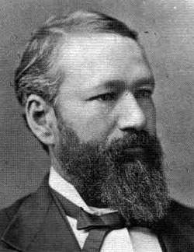
Plessy v. Ferguson (1896)
The object of the amendment was undoubtedly to enforce the absolute equality of the two races before the law, but, in the nature of things, it could not have been intended to abolish distinctions based upon color, or to enforce social, as distinguished from political, equality, or a commingling of the two races upon terms unsatisfactory to either. Laws permitting, and even requiring, their separation in places where they are liable to be brought into contact do not necessarily imply the inferiority of either race to the other, and have been generally, if not universally, recognized as within the competency of the state legislatures in the exercise of their police power.

Slide 41
Plessy v. Ferguson (1896)
So far, then, as a conflict with the Fourteenth Amendment is concerned, the case reduces itself to the question whether the statute of Louisiana is a reasonable regulation, and, with respect to this, there must necessarily be a large discretion on the part of the legislature.
Is this judicial activism or restraint?

Slide 42
Plessy v. Ferguson (1896)
We consider the underlying fallacy of the plaintiff's argument to consist in the assumption that the enforced separation of the two races stamps the colored race with a badge of inferiority. If this be so, it is not by reason of anything found in the act, but solely because the colored race chooses to put that construction upon it…. The argument also assumes that social prejudices may be overcome by legislation, and that equal rights cannot be secured to the negro except by an enforced commingling of the two races. We cannot accept this proposition. If the two races are to meet upon terms of social equality, it must be the result of natural affinities, a mutual appreciation of each other's merits, and a voluntary consent of individuals.

Slide 43
Plessy v. Ferguson (1896)
Legislation is powerless to eradicate racial instincts or to abolish distinctions based upon physical differences, and the attempt to do so can only result in accentuating the difficulties of the present situation. If the civil and political rights of both races be equal, one cannot be inferior to the other civilly or politically. If one race be inferior to the other socially, the Constitution of the United States cannot put them upon the same plane.

Slide 44
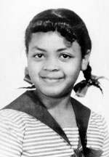
Brown v. Board of Education (1954)
…[T]here are findings below that the Negro and white schools involved have been equalized, or are being equalized, with respect to buildings, curricula, qualifications and salaries of teachers, and other "tangible" factors. Our decision, therefore, cannot turn on merely a comparison of these tangible factors in the Negro and white schools involved in each of the cases. We must look instead to the effect of segregation itself on public education.

Slide 45
Brown v. Board of Education (1954)
Today, education is perhaps the most important function of state and local governments. Compulsory school attendance laws and the great expenditures for education both demonstrate our recognition of the importance of education to our democratic society. It is required in the performance of our most basic public responsibilities, even service in the armed forces. It is the very foundation of good citizenship. Today it is a principal instrument in awakening the child to cultural values, in preparing him for later professional training, and in helping him to adjust normally to his environment. In these days, it is doubtful that any child may reasonably be expected to succeed in life if he is denied the opportunity of an education. Such an opportunity, where the state has undertaken to provide it, is a right which must be made available to all on equal terms.

Slide 46
Brown v. Board of Education (1954)
We come then to the question presented: Does segregation of children in public schools solely on the basis of race, even though the physical facilities and other "tangible" factors may be equal, deprive the children of the minority group of equal educational opportunities? We believe that it does…. We conclude that, in the field of public education, the doctrine of "separate but equal" has no place. Separate educational facilities are inherently unequal. Therefore, we hold that the plaintiffs…are, by reason of the segregation complained of, deprived of the equal protection of the laws guaranteed by the Fourteenth Amendment.

Slide 47
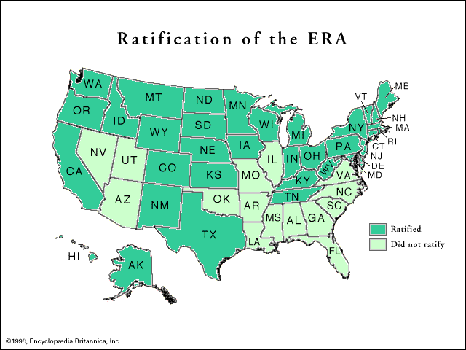
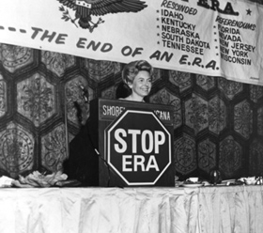
Equal Rights Amendment
“Equality of rights under the law shall not be denied or abridged by the United States or by any State on account of sex.”

Slide 48
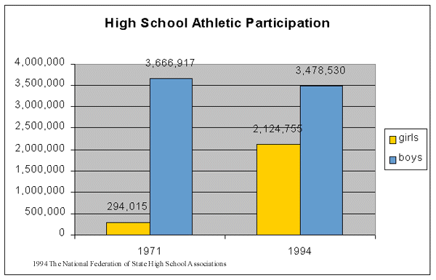
Impact of Title IX

Slide 49
Is the use of contraception protected by a right to privacy?
The present case, then, concerns a relationship lying within the zone of privacy created by several fundamental constitutional guarantees. And it concerns a law which, in forbidding the use of contraceptives, rather than regulating their manufacture or sale, seeks to achieve its goals by means having a maximum destructive impact upon that relationship. Such a law cannot stand in light of the familiar principle, so often applied by this Court, that a governmental purpose to control or prevent activities constitutionally subject to state regulation may not be achieved by means which sweep unnecessarily broadly and thereby invade the area of protected freedoms. Would we allow the police to search the sacred precincts of marital bedrooms for telltale signs of the use of contraceptives? The very idea is repulsive to the notions of privacy surrounding the marriage relationship.
Mr. Justice Douglas
Griswold v. Connecticut (1965)

Slide 50
Is abortion part of a fundamental right to privacy?
This right of privacy, whether it be founded in the Fourteenth Amendment's concept of personal liberty and restrictions upon state action…or…in the Ninth Amendment's reservation of rights to the people, is broad enough to encompass a woman's decision whether or not to terminate her pregnancy. The detriment that the State would impose upon the pregnant woman by denying this choice altogether is apparent. Specific and direct harm medically diagnosable even in early pregnancy may be involved. Maternity, or additional offspring, may force upon the woman a distressful life and future. Psychological harm may be imminent. Mental and physical health may be taxed by child care. There is also the distress, for all concerned, associated with the unwanted child, and there is the problem of bringing a child into a family already unable, psychologically and otherwise, to care for it. In other cases, as in this one, the additional difficulties and continuing stigma of unwed motherhood may be involved. All these are factors the woman and her responsible physician necessarily will consider in consultation.
Mr. Justice Blackmun
Roe v. Wade (1973)

Slide 51
Is the right to an abortion absolute?
[Some] argue that the woman's right [to an abortion] is absolute and that she is entitled to terminate her pregnancy at whatever time, in whatever way, and for whatever reason she alone chooses. With this we do not agree….The Court's decisions recognizing a right of privacy also acknowledge that some state regulation in areas protected by that right is appropriate. As noted above, a State may properly assert important interests in safeguarding health, in maintaining medical standards, and in protecting potential life. At some point in pregnancy, these respective interests become sufficiently compelling to sustain regulation of the factors that govern the abortion decision. The privacy right involved, therefore, cannot be said to be absolute. In fact, it is not clear to us that the claim asserted by some amici that one has an unlimited right to do with one's body as one pleases bears a close relationship to the right of privacy previously articulated in the Court's decisions. The Court has refused to recognize an unlimited right of this kind in the past….We, therefore, conclude that the right of personal privacy includes the abortion decision, but that this right is not unqualified, and must be considered against important state interests in regulation.
Mr. Justice Blackmun
Roe v. Wade (1973)

Slide 52
Is a fetus a “person?”
The appellee and certain amici argue that the fetus is a "person" within the language and meaning of the Fourteenth Amendment. In support of this, they outline at length and in detail the well known facts of fetal development. If this suggestion of personhood is established, the appellant's case, of course, collapses, for the fetus' right to life would then be guaranteed specifically by the Amendment….The Constitution does not define "person" in so many words. But in nearly all these instances, the use of the word is such that it has application only post-natally. None indicates, with any assurance, that it has any possible pre-natal application. All this, together with our observation, supra, that, throughout the major portion of the 19th century, prevailing legal abortion practices were far freer than they are today, persuades us that the word "person," as used in the Fourteenth Amendment, does not include the unborn.
Mr. Justice Blackmun
Roe v. Wade (1973)

Slide 53
Scott v. Sandford (1857)
Roe v. Wade (1973)
The question is simply this: can a negro whose ancestors were imported into this country and sold as slaves become a member of the political community formed and brought into existence by the Constitution of the United States, and as such become entitled to all the rights, and privileges, and immunities, guarantied by that instrument to the citizen?...We think they are not, and that they are not included, and were not intended to be included, under the word "citizens" in the Constitution, and can therefore claim none of the rights and privileges which that instrument provides for and secures to citizens of the United States. On the contrary, they were at that time considered as a subordinate and inferior class of beings who had been subjugated by the dominant race, and, whether emancipated or not, yet remained subject to their authority, and had no rights or privileges but such as those who held the power and the Government might choose to grant them.
The appellee and certain amici argue that the fetus is a "person" within the language and meaning of the Fourteenth Amendment. In support of this, they outline at length and in detail the well known facts of fetal development. If this suggestion of personhood is established, the appellant's case, of course, collapses, for the fetus' right to life would then be guaranteed specifically by the Amendment ….The Constitution does not define "person" in so many words. But in nearly all these instances, the use of the word is such that it has application only post-natally. None indicates, with any assurance, that it has any possible pre-natal application. All this, together with our observation, supra, that, throughout the major portion of the 19th century, prevailing legal abortion practices were far freer than they are today, persuades us that the word "person," as used in the Fourteenth Amendment, does not include the unborn.

Slide 54
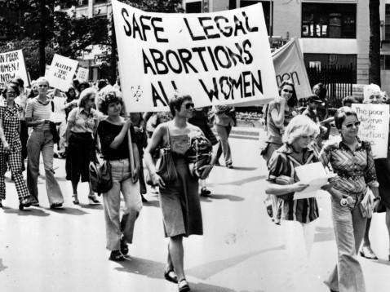
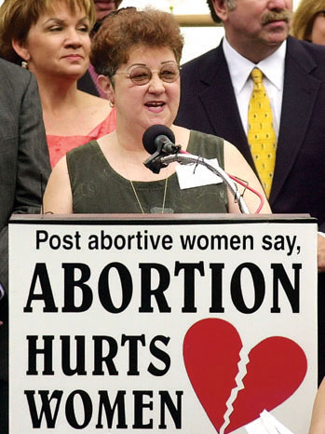
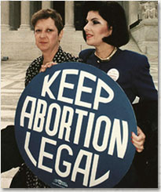
Roe v. Wade (1973)
Norma McCorvey
“Roe no more”

Slide 55
Can a private club discriminate?
The Court has never held, of course, that discrimination by an otherwise private entity would be violative of the Equal Protection Clause if the private entity receives any sort of benefit or service at all from the State, or if it is subject to state regulation in any degree whatever. Since state-furnished services include such necessities of life as electricity, water, and police and fire protection, such a holding would utterly emasculate the distinction between private, as distinguished from state, conduct set forth in [previous cases] and adhered to in subsequent decisions. Our holdings indicate that, where the impetus for the discrimination is private, the State must have "significantly involved itself with invidious discriminations," in order for the discriminatory action to fall within the ambit of the constitutional prohibition.
Mr. Justice Rehnquist
Moose Lodge v. Irvis (1972)

